Slide 1
JAVA Lecture 5
Nested Class and Command Line Arguments

Slide 2





Slide 3
Nested Class in JAVA

Slide 4
What is a Nested Class?
• A nested class is a class declared inside another class.
• Used to group related functionality together.
• Helps improve encapsulation and organize code better.
Types of Nested Classes:
Static Nested Classes
Non-Static Inner Classes
Local Inner Classes
Anonymous Inner Classes

Slide 5
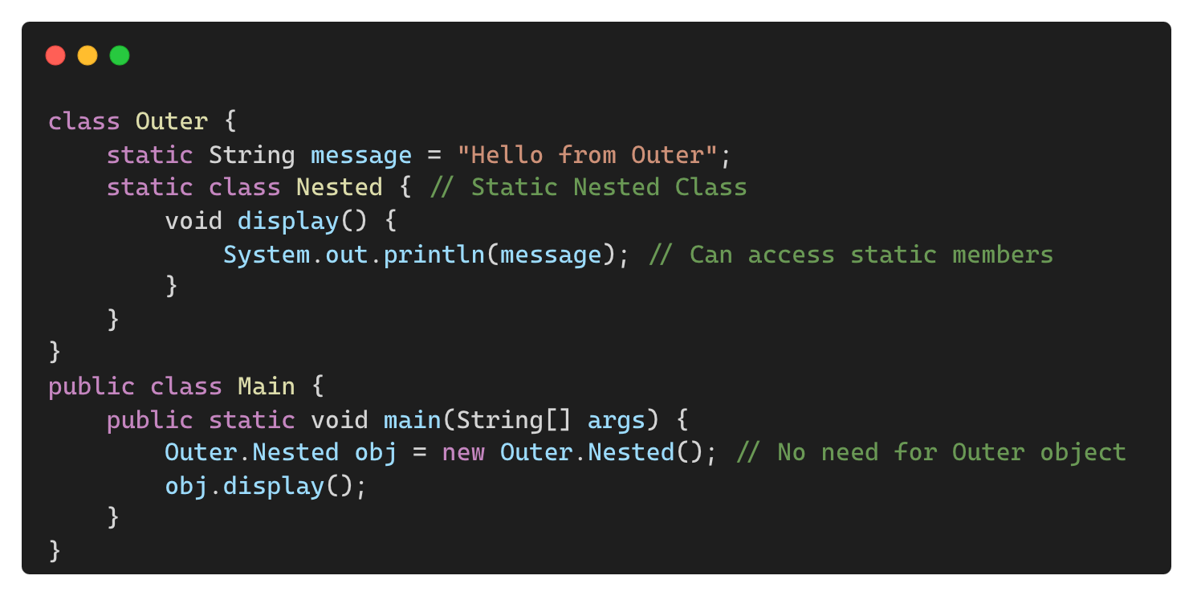
Static Nested Classes
A nested class declared with static keyword.
It can access only static members of the outer class.
Output:
Hello from Outer

Slide 6
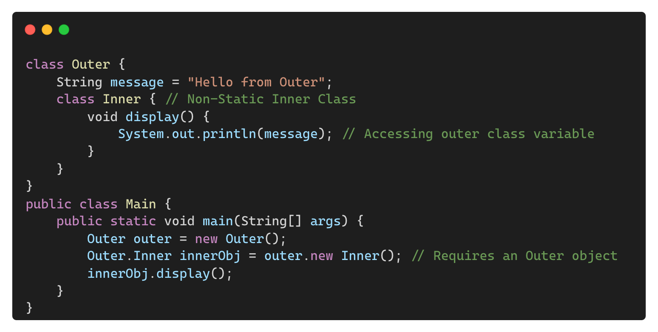
Non-Static Inner Classes
An inner class that needs an instance of the outer class to be created.
Can access both static and non-static members of the outer class.
Output:
Hello from Outer

Slide 7
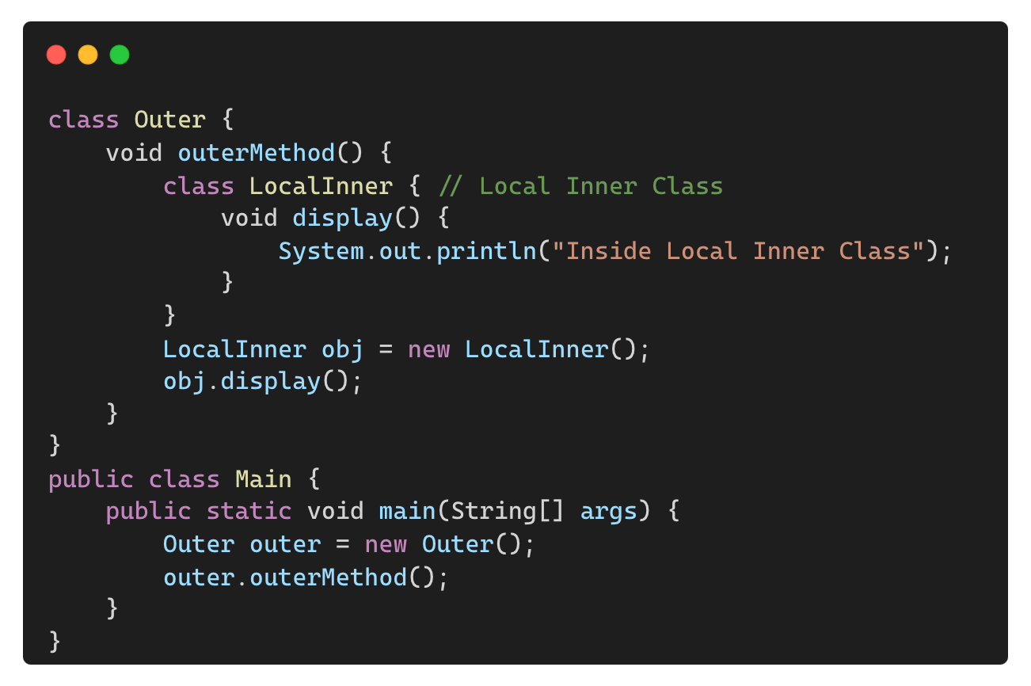
Local Inner Classes
A class declared inside a method.
Cannot be accessed outside the method.
Output:
Inside Local Inner Class

Slide 8
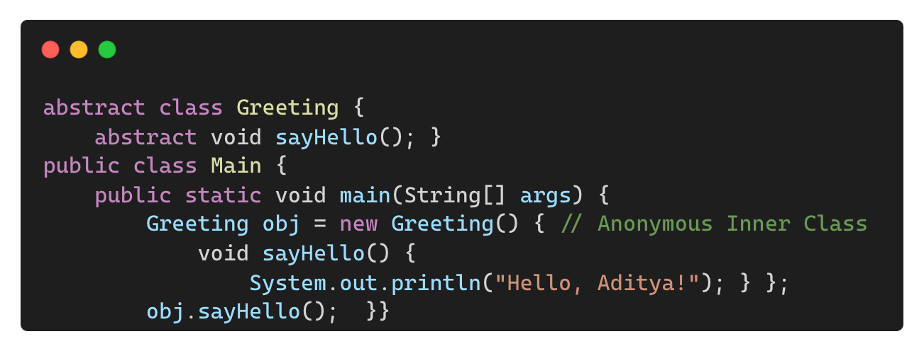
Anonymous Inner Classes
A class without a name, used for one-time implementation.
Useful for event handling and functional programming.
Output:
Hello, Aditya!

Slide 9
Differences Between Nested Classes
Feature | Static Nested Class | Inner Class | Local Inner Class | Anonymous Inner Class
Requires Outer Class Instance | No | Yes | Yes | Yes
Can Access Static Members | Yes | Yes | Yes | Yes
Can Access Non-Static Members | No | Yes | Yes | Yes
Use Case | Grouping static logic | Encapsulating behavior | Temporary class inside a method | Single-use class

Slide 10
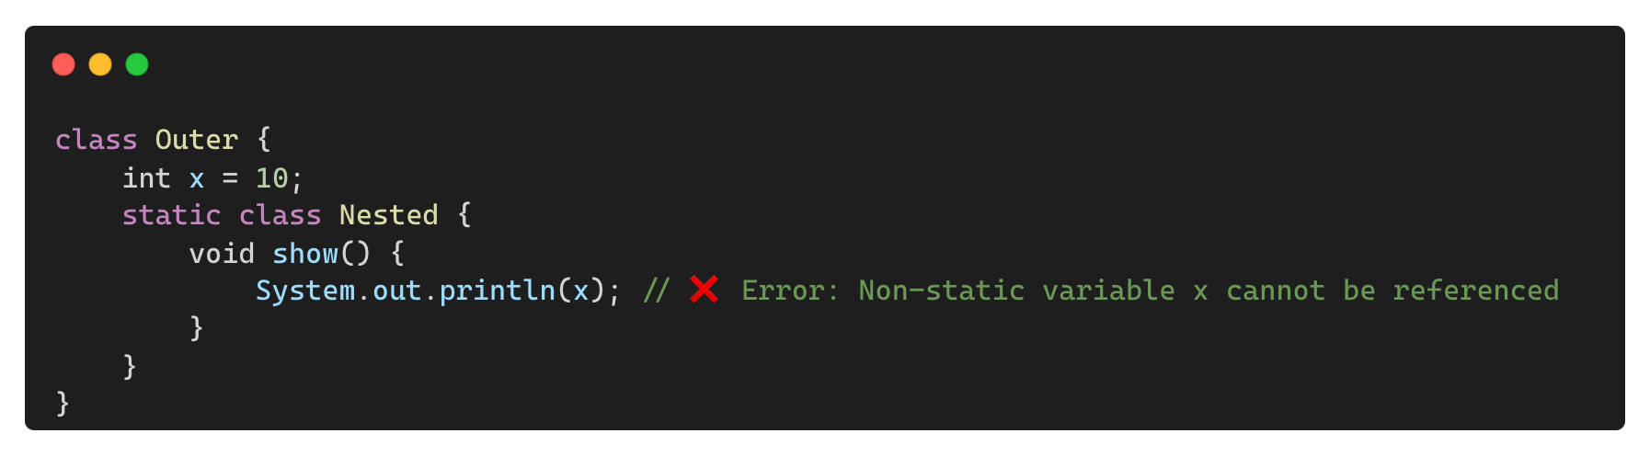
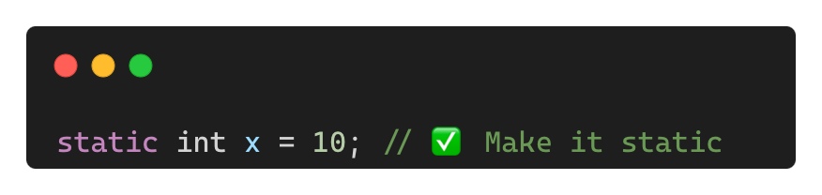
Common Mistakes When Using Nested Classes
❌ Trying to Access Non-Static Members in a Static Nested Class
✅ Solution:

Slide 11

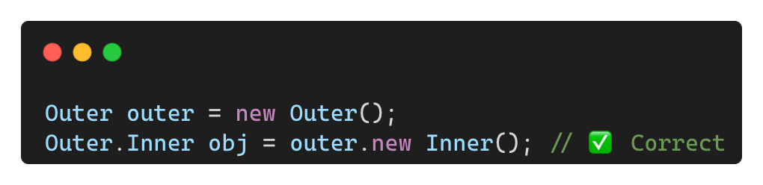
Common Mistakes When Using Nested Classes (Contd.)
❌ Forgetting to Instantiate Inner Classes Correctly
✅ Solution:

Slide 12
Command Line Arguments

Slide 13
What are Command Line Arguments?
Values passed to a java program during execution via the terminal or command prompt.
They allow users to provide input without modifying the program.
The use cases of command line arguments:
Providing configuration settings
Passing file names or data for processing
Automating execution with different inputs

Slide 14
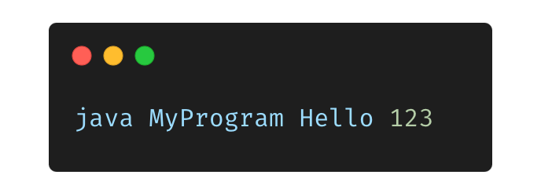
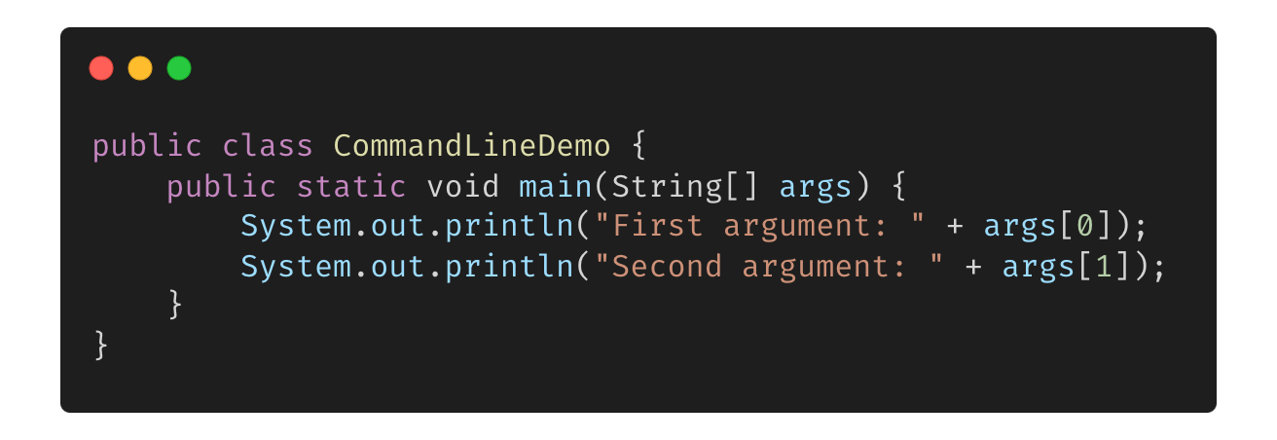
How Command Line Arguments Work?
Command line arguments are stored in the String[] args array.
Example execution:
“Hello” and “123” are passed as arguments
Java Code Example:
Output:
First argument: Hello
Second argument: 123

Slide 15
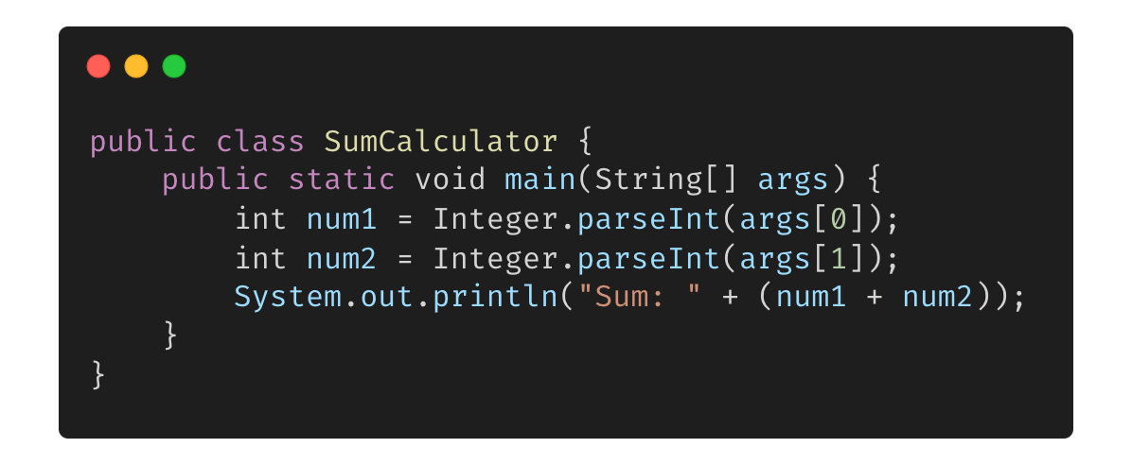
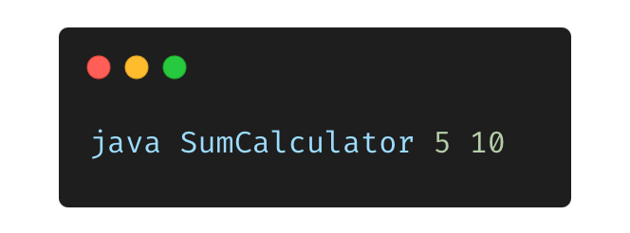
Accessing and using Arguments
Arguments are stored in an array (args[]).
Each argument is accessed using its index:
Execution:
Output:
Sum: 15

Slide 16
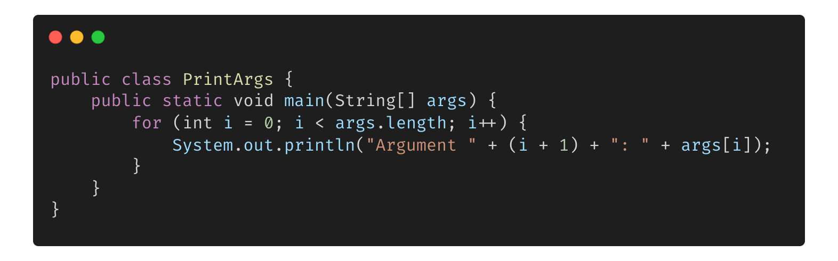

Handling Multiple Arguments Dynamically
Looping through all arguments:
Execution:
Output:
Argument 1: Java
Argument 2: is
Argument 3: awesome!

Slide 17
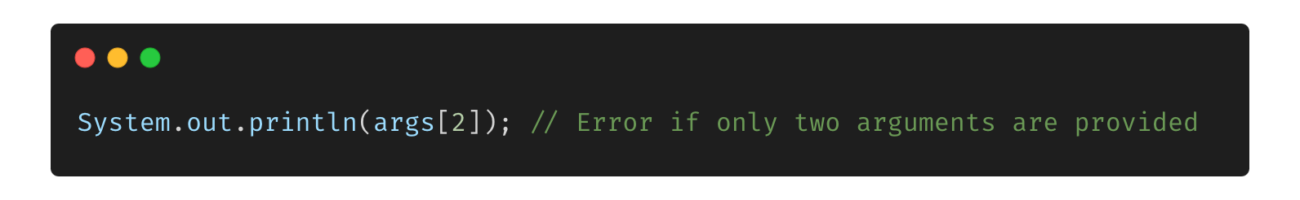
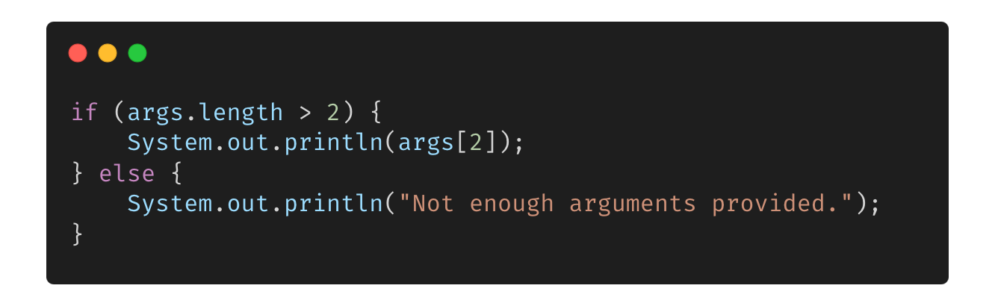
Common Errors and their Solutions
Accessing Non-Existing Arguments (Index Out of Bounds Exception)
Solution: Always check the length before accessing:

Slide 18
Advantages of Using Command Line Arguments
Allows dynamic input without modifying code.
Useful for automation and script execution.
Enables testing with multiple input values easily.
Saves time by avoiding hardcoded values.

Slide 19
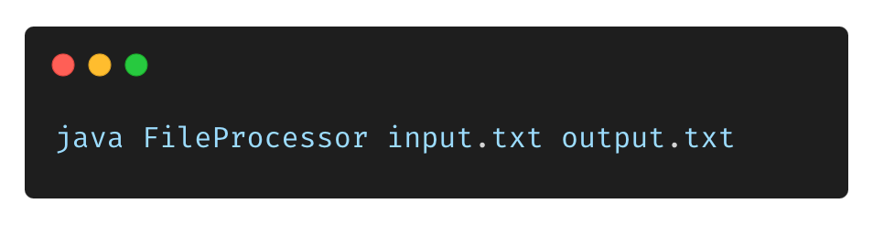
Practical Applications of Command Line Arguments
Configurable applications (e.g., specifying file paths, settings)
Automating test cases with different inputs
Developing lightweight utilities that don’t require use interaction.

Slide 20
THANK YOU

